Slide 1
SPAM
HAM
NATURAL LANGUAGE PROCESSING
PROJECT-1
MAIBASSAR MIRAS

Slide 2
PROJECT OVERVIEW
THIS PROJECT IMPLEMENTS AN AUTOMATIC TEXT CLASSIFICATION SYSTEM THAT IDENTIFIES WHETHER A MESSAGE IS SPAM OR HAM (NON-SPAM).
THE PROJECT DEMONSTRATES THE COMPLETE NLP WORKFLOW:
  DATA PREPROCESSING AND TEXT CLEANING
  MODEL TRAINING
  PERFORMANCE EVALUATION
THE MAIN OBJECTIVE IS TO CLASSIFY TEXT MESSAGES BASED ON THEIR CONTENT, USING NATURAL LANGUAGE PROCESSING (NLP) TECHNIQUES AND CLASSICAL MACHINE LEARNING ALGORITHMS.

Slide 3
PRESENTED BY
MIRAS MAIBASSAR
WHAT WE DO & METHODS USED
What We Do
  Load a dataset of text messages
  Clean and normalize the text data
  Convert textual labels into numerical format
  Split the dataset into:
    training set
    validation set
    test set
  Train a text classification model
Methods Used
  Natural Language Processing (NLP)
  Bag-of-Words representation
  Naive Bayes classifier
  Laplace smoothing
  Log-probabilities for numerical stability

Slide 4

PROJECT GOAL
TO BUILD AN INTERPRETABLE AND EFFICIENT MODEL CAPABLE OF AUTOMATICALLY DETECTING SPAM MESSAGES BASED ON TEXT CONTENT.
WHY THIS PROJECT MATTERS
  SPAM DETECTION IS A REAL-WORLD NLP PROBLEM
  TEXT DATA REQUIRES PREPROCESSING AND PROBABILISTIC REASONING
  NAIVE BAYES PROVIDES STRONG BASELINES FOR TEXT CLASSIFICATION
  MODEL INTERPRETABILITY IS CRITICAL FOR TRUST AND ANALYSIS
Expected Outcome
  Accurate classification of unseen messages
  High accuracy on validation and test datasets
  Clear understanding of probabilistic models in NLP
  A scalable and extensible solution for text classification tasks

Slide 5
DATASET CLASS — PREPROCESSING & LABEL ENCODING
TEXT PREPROCESSING
• LowercasING ALL MESSAGES
• REMOVING PUNCTUATION USING REGULAR EXPRESSIONS
• NORMALIZING RAW TEXT INPUT
THIS REDUCES NOISE AND IMPROVES MODEL PERFORMANCE.
LABEL ENCODING
• Class labelS ARE CONVERTED TO NUMBERS
• LABEL2NUM: LABEL → NUMERIC VALUE
• NUM2LABEL: NUMERIC VALUE → LABEL
THIS ALLOWS THE MODEL TO WORK WITH CATEGORICAL CLASSES.
The Dataset class is responsible for preparing raw SMS messages
for machine learning.
It performs text cleaning, label encoding,
and prepares the data for training and evaluation.
The goal is to transform unstructured text
into a clean and numerical format suitable for a classifier.
TEXT DATA → MACHINE-READABLE FORMAT
PRESENTED BY
MIRAS MAIBASSAR

Slide 6
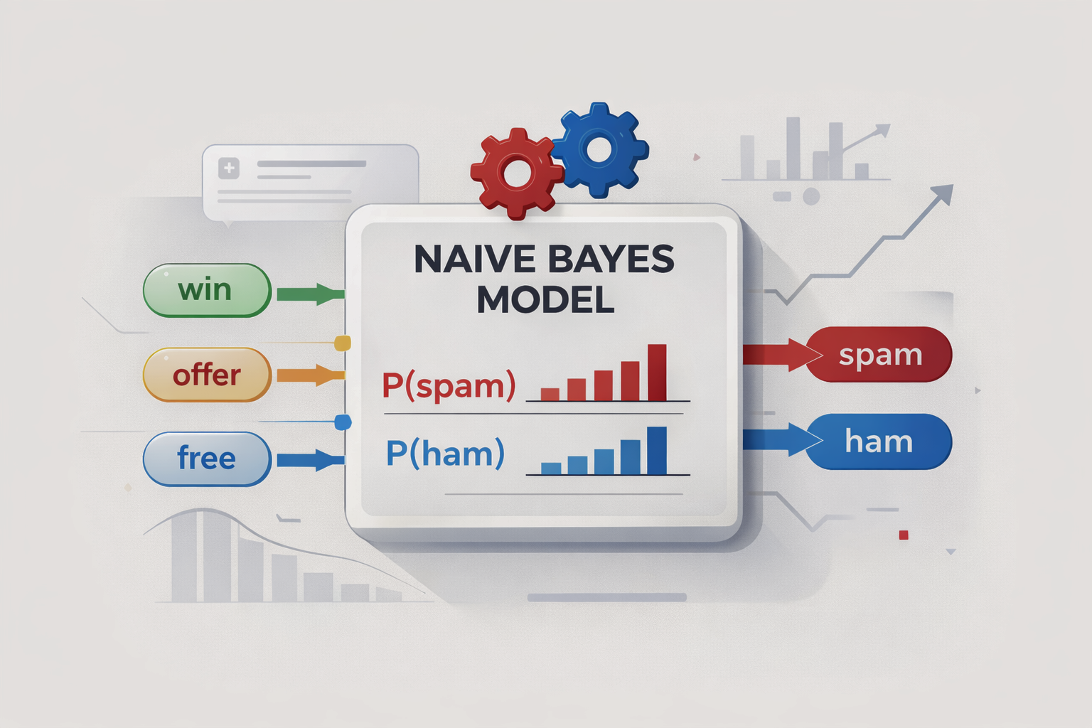
NAIVE BAYES MODEL
PROBABILISTIC TEXT CLASSIFICATION
The model is a custom implementation
of Multinomial Naive Bayes
for SMS spam classification.
It uses word frequencies and probability theory
to determine whether a message is spam or ham.
The model is trained from scratch
without external machine learning libraries.
KEY CHARACTERISTICS:
• BAG-OF-WORDS REPRESENTATION
• LOG-PROBABILITIES
• LAPLACE SMOOTHING (ALPHA)
• HIGH INTERPRETABILITY
PRESENTED BY
MIRAS MAIBASSAR

Slide 7
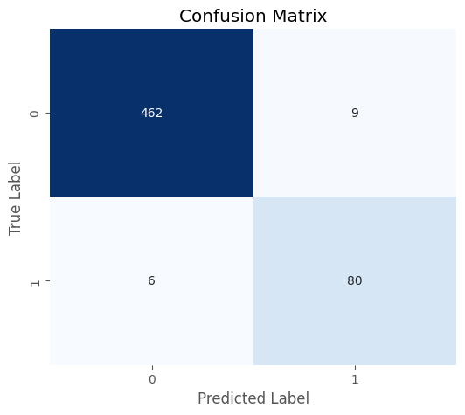
CONFUSION MATRIX EXPLANATION
INTERPRETATION
  THE MODEL CORRECTLY CLASSIFIES THE MAJORITY OF MESSAGES.
  ONLY A SMALL NUMBER OF HAM MESSAGES ARE INCORRECTLY MARKED AS SPAM, WHICH IS IMPORTANT FOR REAL-WORLD USABILITY.
  THE MODEL DEMONSTRATES HIGH ACCURACY AND STRONG RELIABILITY, ESPECIALLY IN DETECTING SPAM MESSAGES.
  FALSE NEGATIVES (SPAM CLASSIFIED AS HAM) ARE MINIMAL, INDICATING GOOD SPAM DETECTION PERFORMANCE.
KEY INSIGHT
THIS CONFUSION MATRIX CONFIRMS THAT THE NAIVE BAYES CLASSIFIER PERFORMS EFFECTIVELY ON TEXT DATA AND ACHIEVES A GOOD BALANCE BETWEEN PRECISION AND RECALL.

Slide 8
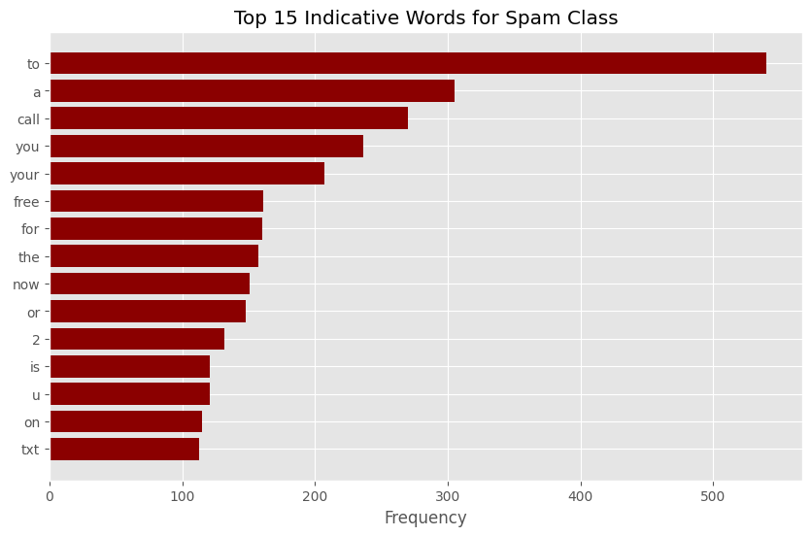
Spam Word Frequency Analysis
Why This Matters
  The diagram demonstrates that the model learns meaningful patterns from data, not random noise.
  It confirms the interpretability of the Naive Bayes approach: we can directly see which words influence predictions.
  Such analysis helps understand why a message is classified as spam.
TOP INDICATIVE WORDS FOR SPAM CLASS
THIS CHART SHOWS THE MOST FREQUENT WORDS APPEARING IN SPAM MESSAGES LEARNED BY THE NAIVE BAYES MODEL DURING TRAINING.
THE MODEL BUILDS A FREQUENCY-BASED REPRESENTATION OF SPAM TEXTS AND IDENTIFIES WORDS THAT ARE HIGHLY INDICATIVE OF THE SPAM CLASS.

Slide 9
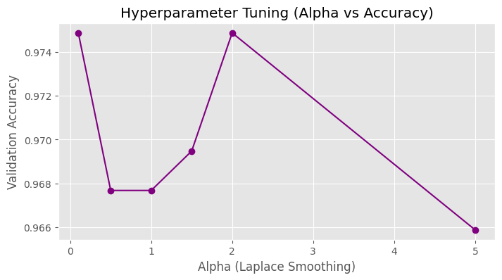
HYPERPARAMETER TUNING (ALPHA)
Hyperparameter Optimization: Laplace Smoothing (α)
In this experiment, we performed hyperparameter tuning for the Naive Bayes classifier by testing different values of the Laplace smoothing parameter (α).
Laplace smoothing controls how the model handles rare or unseen words and helps prevent zero probabilities during classification.
RESULTS & INTERPRETATION
  THE BEST VALIDATION PERFORMANCE WAS ACHIEVED AT Α = 0.1.
  SMALLER VALUES OF Α PROVIDED BETTER GENERALIZATION FOR THIS DATASET.
  LARGER Α VALUES LED TO EXCESSIVE SMOOTHING, SLIGHTLY REDUCING ACCURACY.

Slide 10
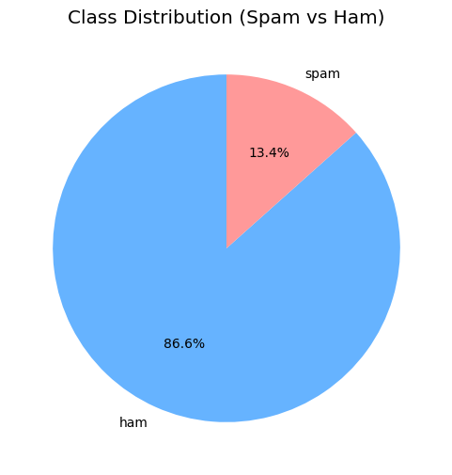
CLASS DISTRIBUTION (EDA)
CLASS DISTRIBUTION: SPAM VS HAM
THIS CHART ILLUSTRATES THE DISTRIBUTION OF CLASSES IN THE DATASET USED FOR TRAINING AND EVALUATION.
  Total samples: 5,572
  Ham messages: 4,825 (≈ 86.6%)
  Spam messages: 747 (≈ 13.4%)
KEY OBSERVATIONS
  The dataset is imbalanced, with a significantly larger number of ham messages.
  Spam messages represent a smaller but important portion of the data.
  Such imbalance is typical for real-world spam detection tasks.

Slide 11
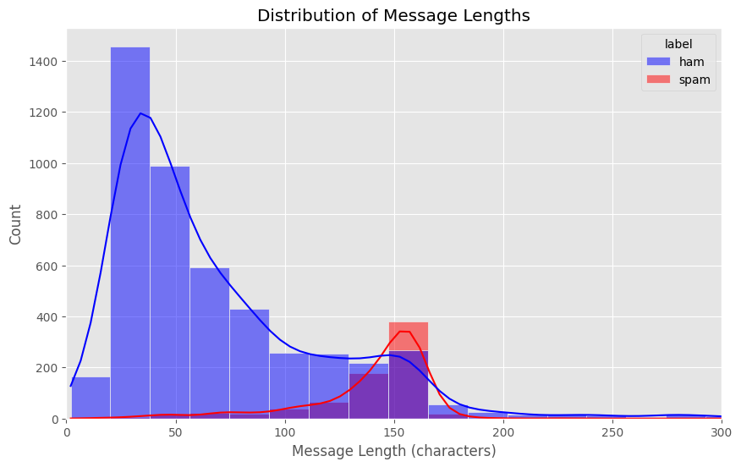
MESSAGE LENGTH ANALYSIS (EDA)
Key Observations
  Ham messages are generally shorter and concentrated at lower character counts.
  Spam messages tend to be longer on average, often containing promotional or informational content.
  There is a noticeable shift in the distribution of spam messages toward higher message lengths.
Distribution of Message Lengths
This plot shows the distribution of message lengths (in characters) for both classes: ham and spam.
WHY THIS MATTERS
  MESSAGE LENGTH PROVIDES AN ADDITIONAL DISCRIMINATIVE SIGNAL FOR CLASSIFICATION.
  LONGER MESSAGES OFTEN INCLUDE:
    ADVERTISEMENTS
    CALL-TO-ACTION PHRASES
    DETAILED OFFERS
  THIS SUPPORTS THE EFFECTIVENESS OF WORD-BASED PROBABILISTIC MODELS SUCH AS NAIVE BAYES.

Slide 12
MODEL INFERENCE EXAMPLES
Real-World Message Classification
This slide demonstrates how the trained Naive Bayes model classifies previously unseen messages.
Several real-world–like examples were passed to the model to evaluate its practical behavior.
Example Predictions
  “You have been selected to receive a £1000 cash prize…”
  → Spam
  “I’ll be at the office around 10 am. See you then.”
  → Ham
  “Your Apple ID has been locked due to unauthorized login attempts…”
  → Spam
  “Did you finish the report for tomorrow?”
  → Ham
  “Shop now! 50% off on all items…”
  → Spam
Interpretation
  The model correctly identifies promotional, urgent, and phishing-like messages as spam.
  Neutral and conversational messages are classified as ham.
  This confirms that the model generalizes well beyond the training dataset.
Key Insight
The inference results show that the classifier is practically usable, interpretable, and effective for real-world spam detection tasks.

